Slide 1
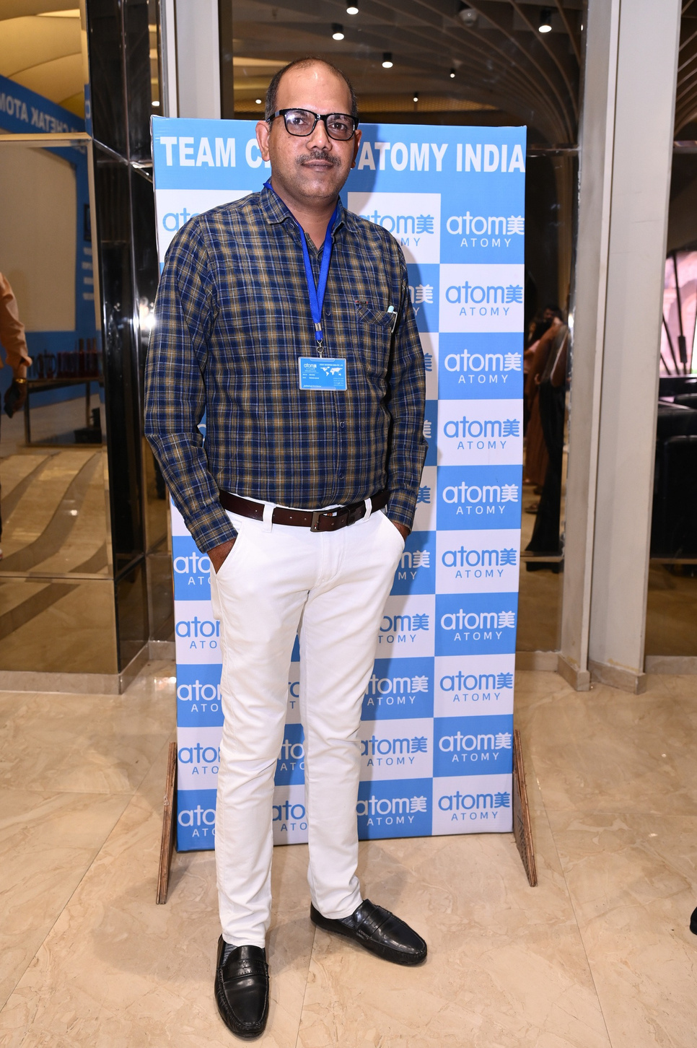


ATOMY
Business
Plan
Parveen Deswal
Agent Team Chetak

Slide 2



ATOMY HIGHLIGHTS
JOIN FREE
NO MONTHLY PURCHASE TARGET
NO ANNUAL FEES
GLOBAL BUSINESS
LIFETIME ACCUMULATED PERSONAL PV
3RD GENERATION INHERITENCE
COMPANY HOSTED SUCCESS SYSTEM
TIME FREEDOM
EARN WHILE SLEEPING

Slide 3

1

Slide 4

2

Slide 5



WORKSHOP DEMONSTRATION INCOME
KOREAN GLASS FACIAL WORKSHOP
3
2100/-
by
TEAM CHETAK
additionally

Slide 6

4

Slide 7
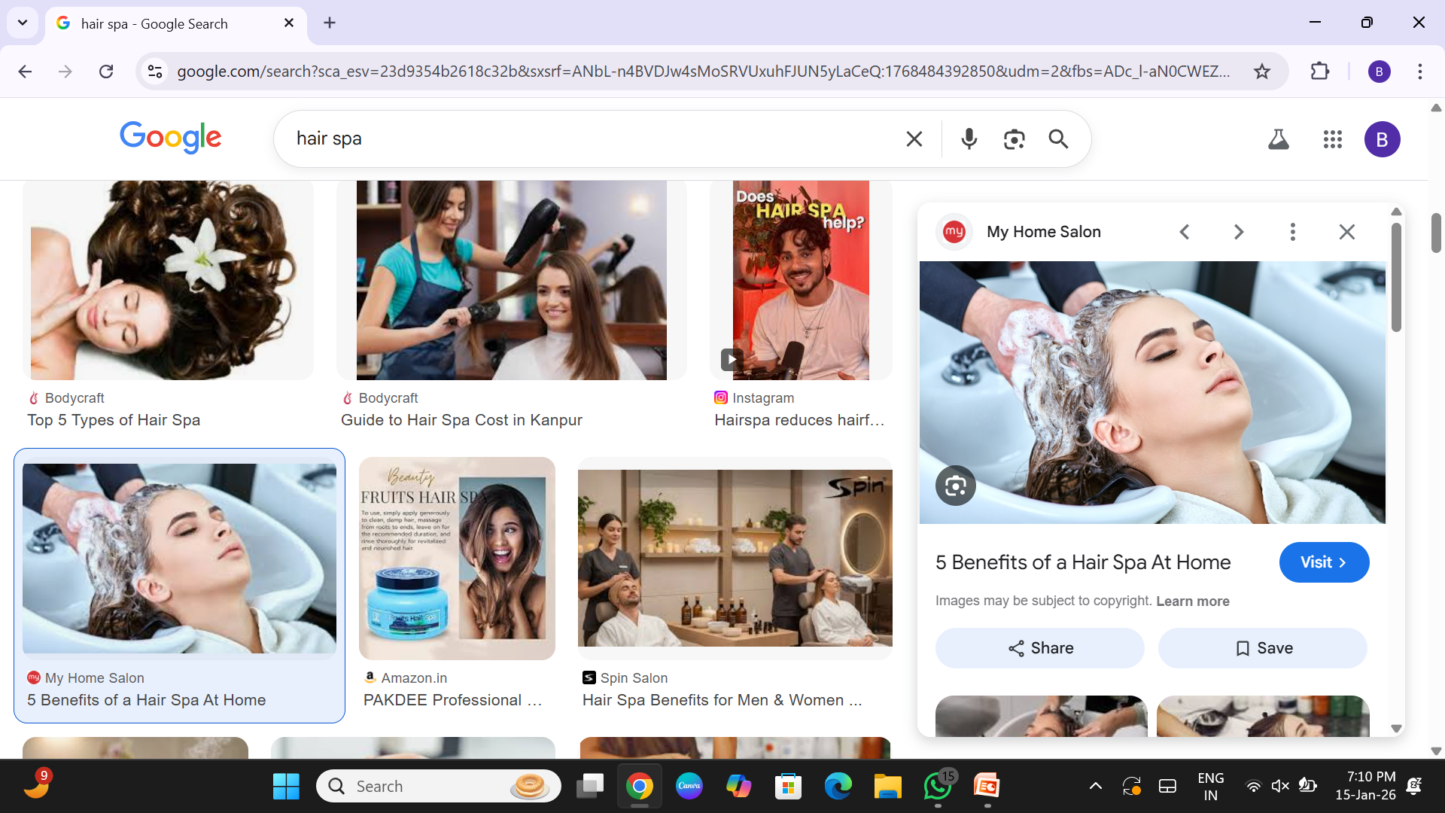
WORKSHOP DEMONSTRATION INCOME
KOREAN HAIR SPA WORKSHOP
5
1100/-
by
TEAM CHETAK
additionally

Slide 8

6

Slide 9

7

Slide 10

8

Slide 11

9

Slide 12

10

Slide 13

11
ON STAGE MEDAL

Slide 14

12

Slide 15


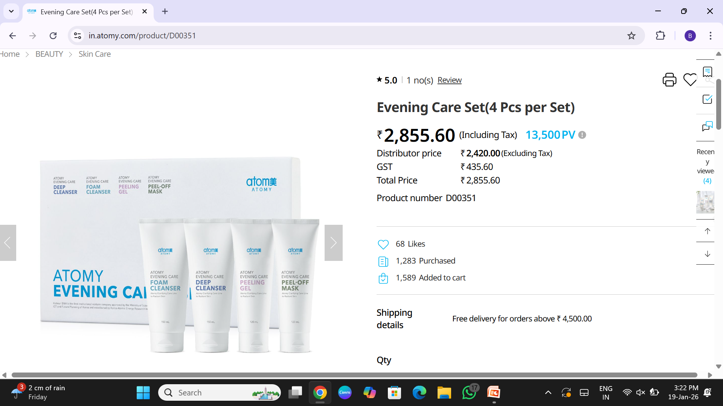

PV
(POINT VALUE)
PV= 13500
DP
(Distributor price)
Rs. 2855/-
MRP
(Maximum retail price)
Rs. 3300

Slide 16
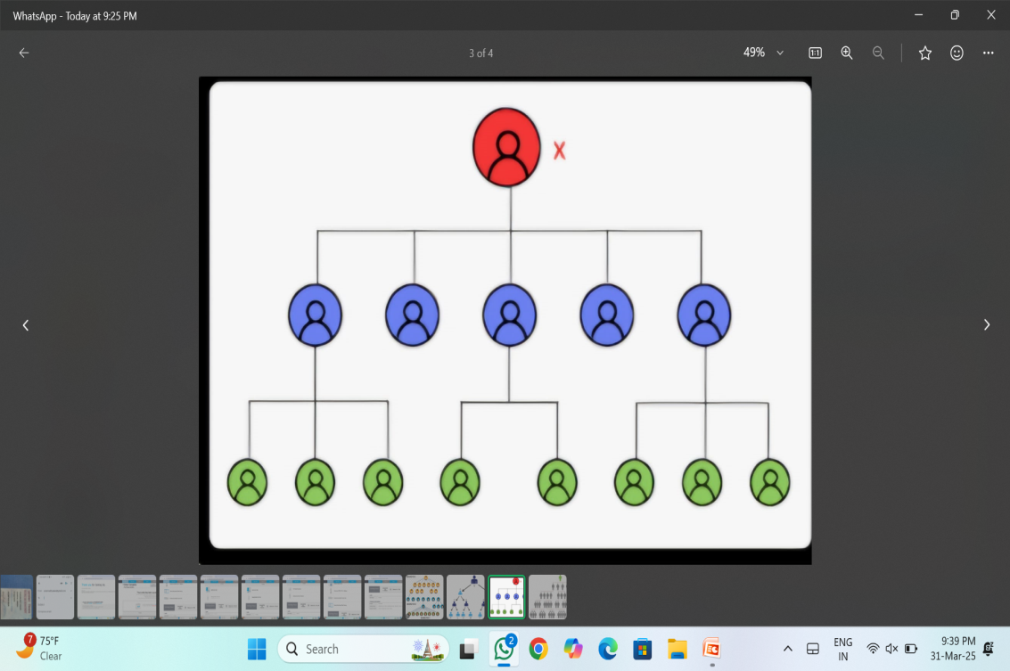
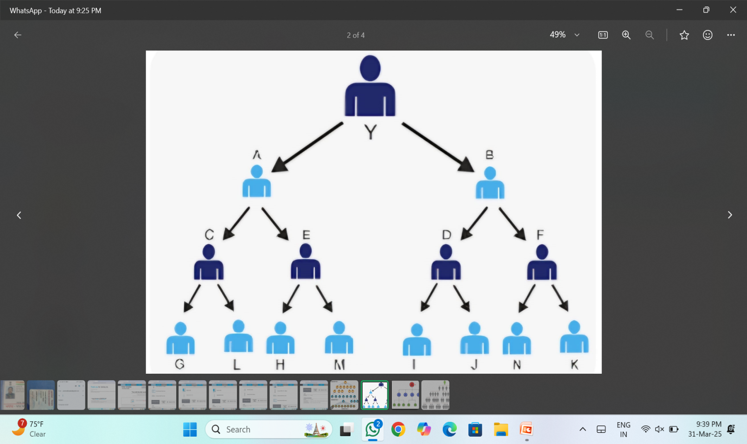
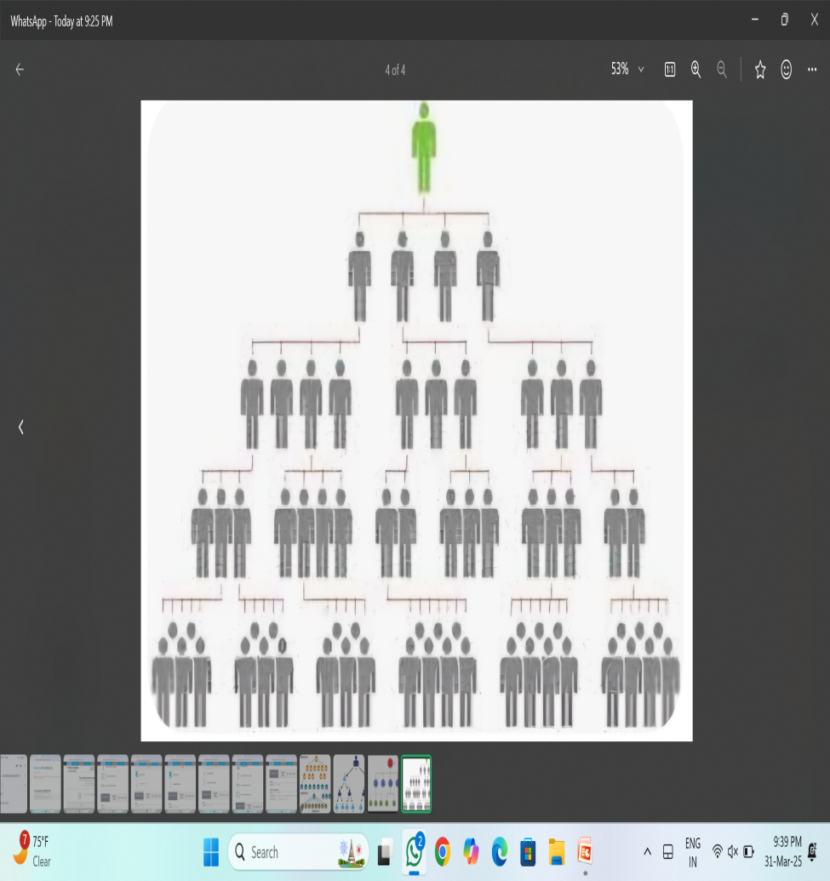
BINARY PLAN
Atomy
GENERATION PLAN

Slide 17





1
RETAIL PROFIT
5 TYPES
OF
EARNING
2
GENERAL COMMISION
3
MASTERSHIP BONUS
4
MASTERSHIP INCENTIVE
5
EDUCATION BONUS

Slide 18

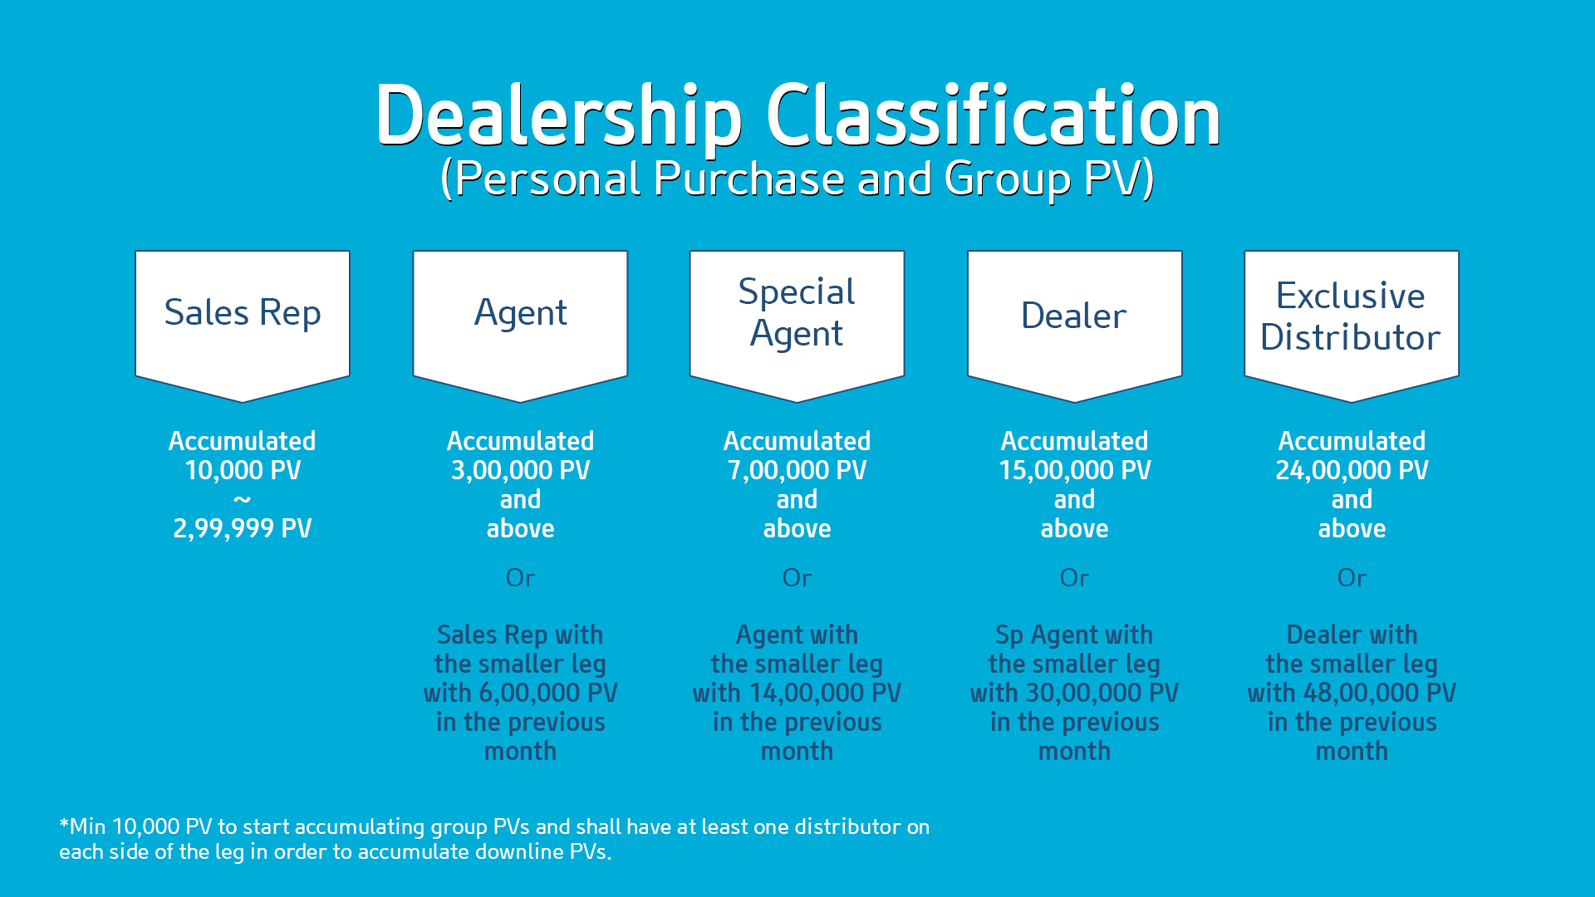
DEALERSHIP CLASSIFICATION
LIFETIME ACCUMULATION

Slide 19

13

Slide 20


Slide 21
14

Slide 22
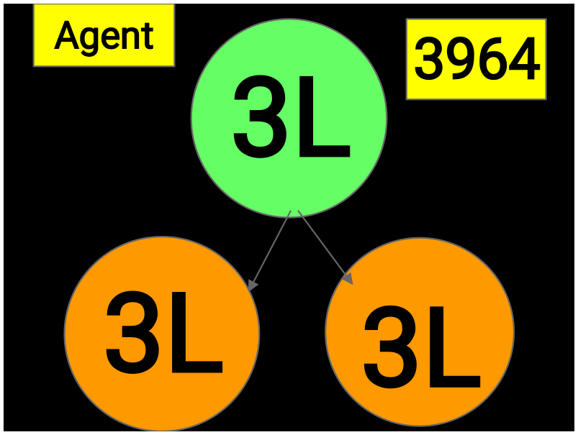
14

Slide 23
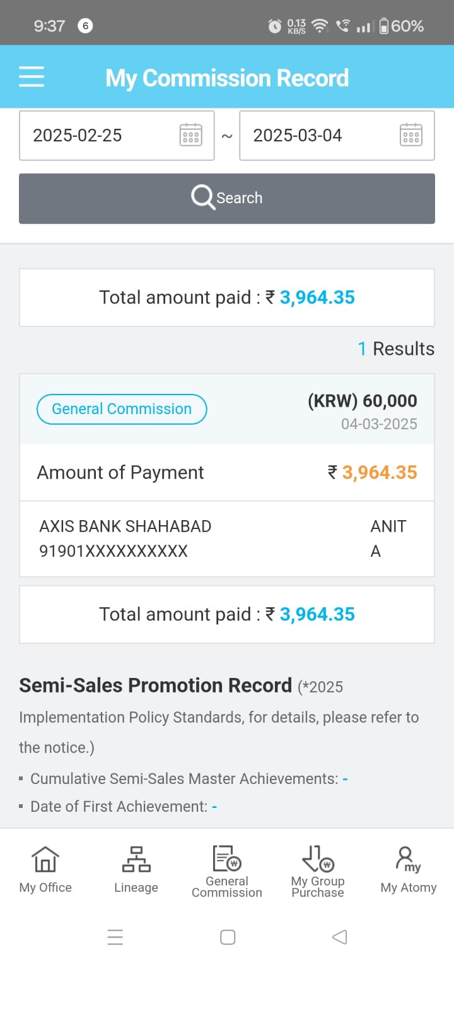
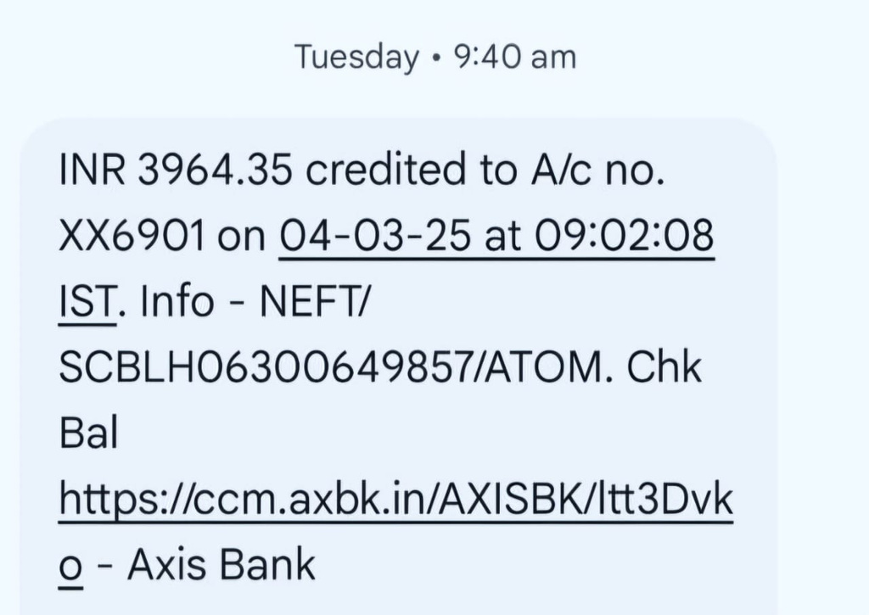

Slide 24
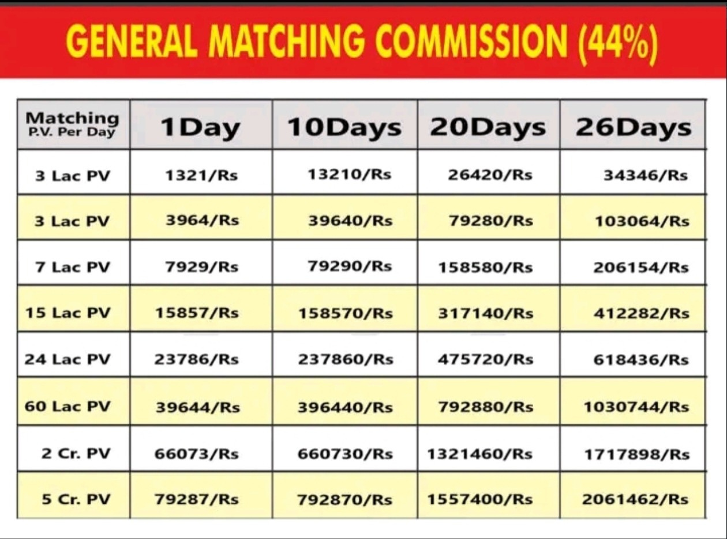

Slide 25
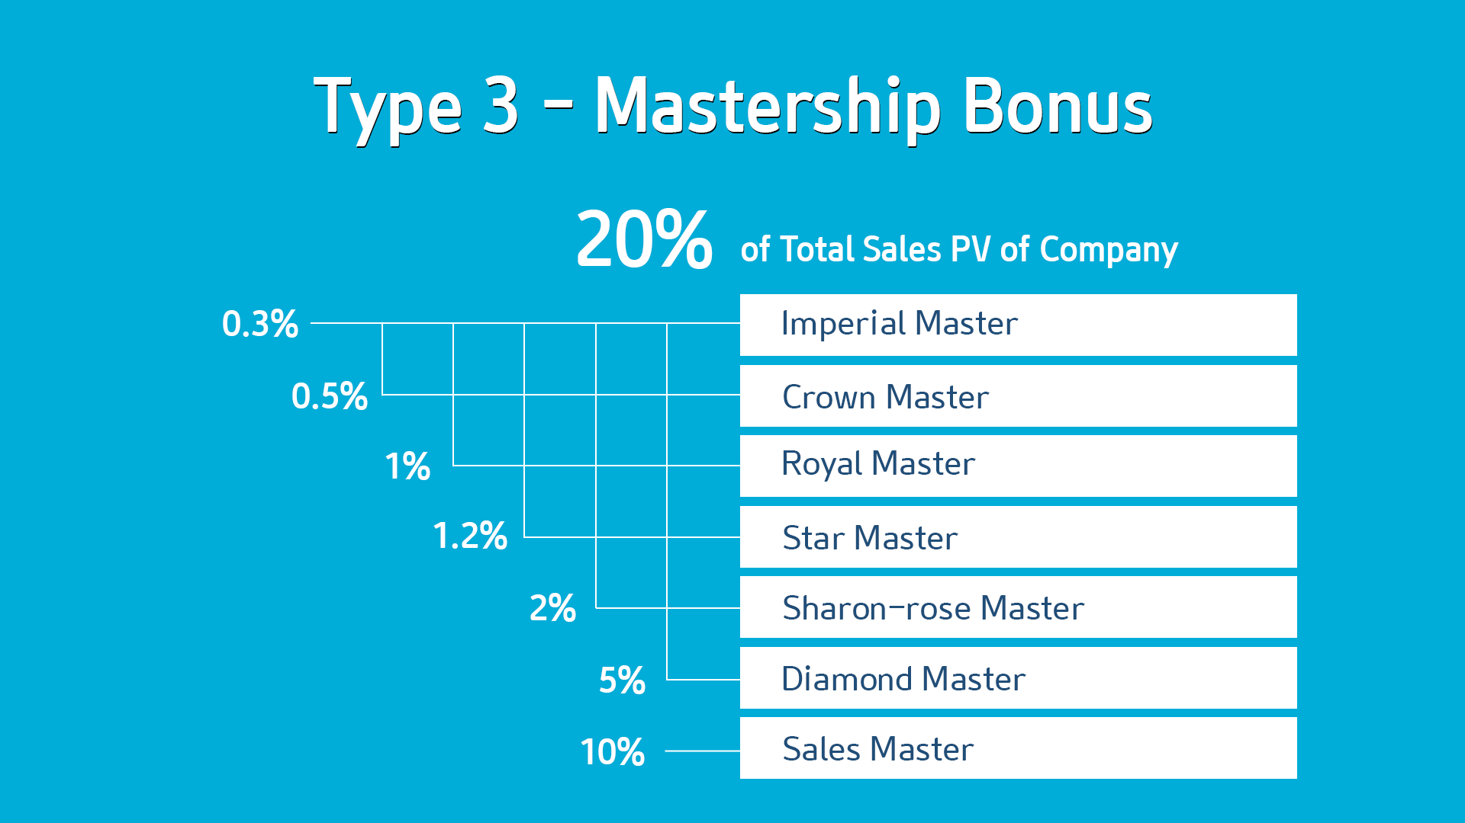

Slide 26
GENERAL COMMISSION
Calculation – Every Tuesday
Payment – Upnext Tuesday
MASTERSHIP BONUS
Calculation – 1-15 And 16-30 Every Month
Payment – 22nd And 7th Of Every Month

Slide 27
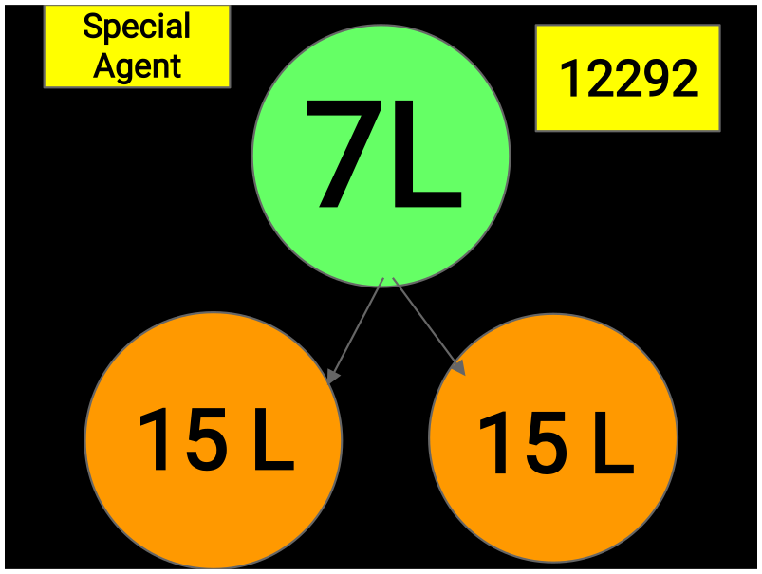
15

Slide 28


26K - 28K
16
SALES
MASTER
INCENTIVE:
30000
25L
25L
TOTAL INCOME
PER CYCLE :
90000

Slide 29


Slide 30
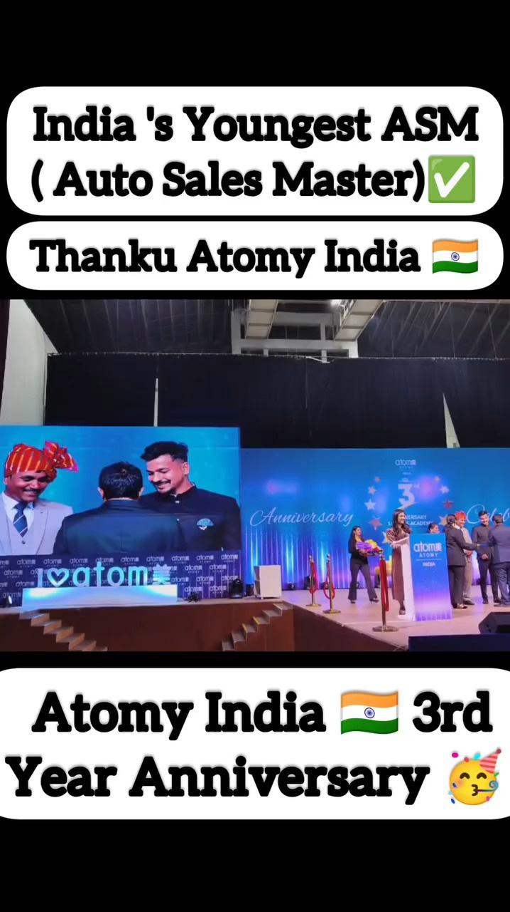

Slide 31
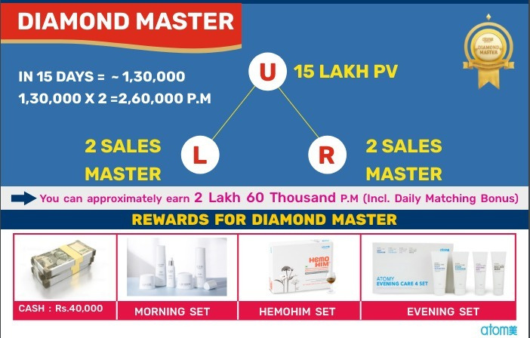
IN 15 DAYS = 130000
INCENTIVE: 90000 CASH
TOTAL INCOME PER CYCLE: 220000
2 NIGHT 3 DAYS MALAYSIA TRIP

Slide 32
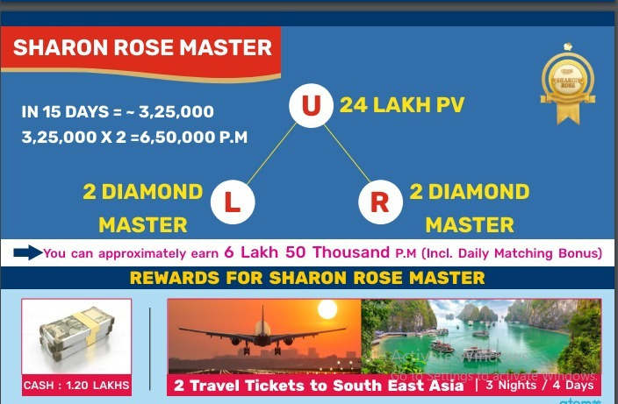
INCENTIVE: 1.2 LAKH CASH
TOTAL INCOME PER CYCLE: 445000
2 PAX TOUR PASSAGE(3 NIGHTS AND 4 DAYS)

Slide 33
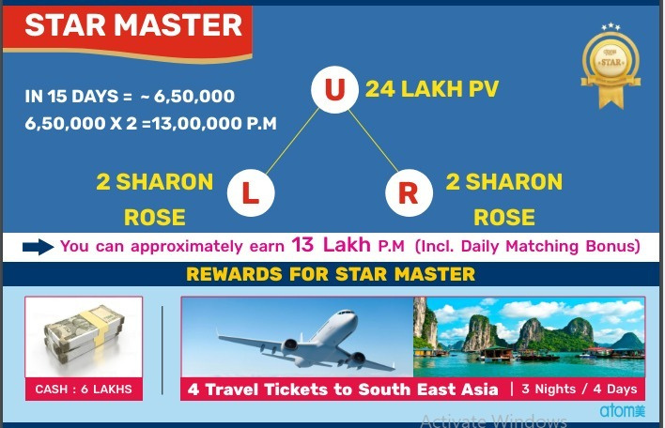
INCENTIVE: 6 LAKH CASH
TOTAL INCOME PER CYCLE: 1250000
4 PAX TOUR PASSAGE(3 NIGHTS AND 4 DAYS)

Slide 34


Slide 35
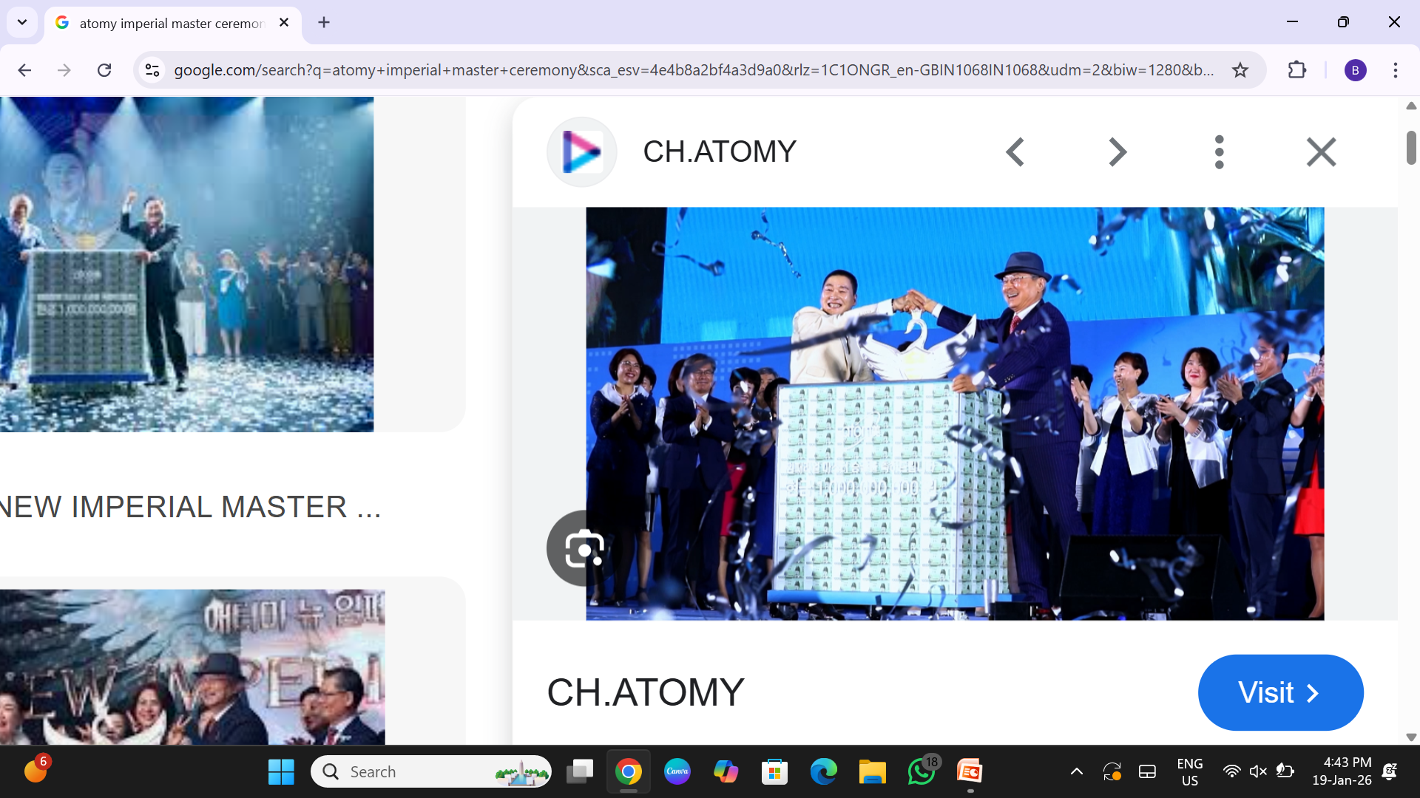
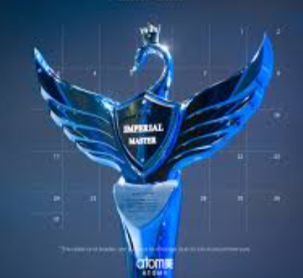
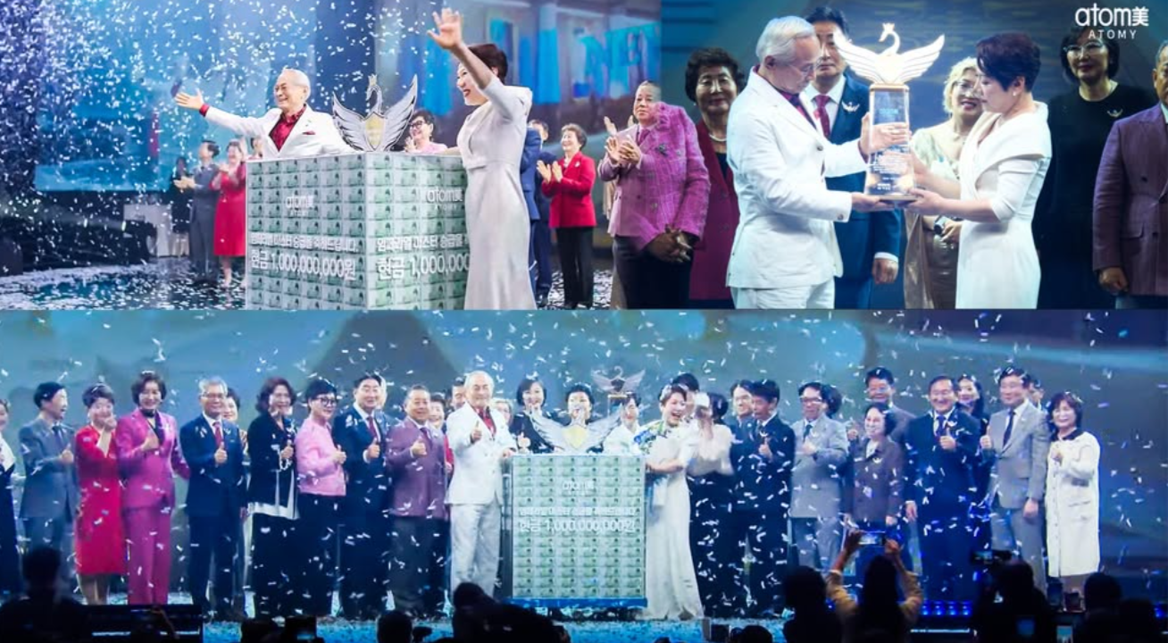
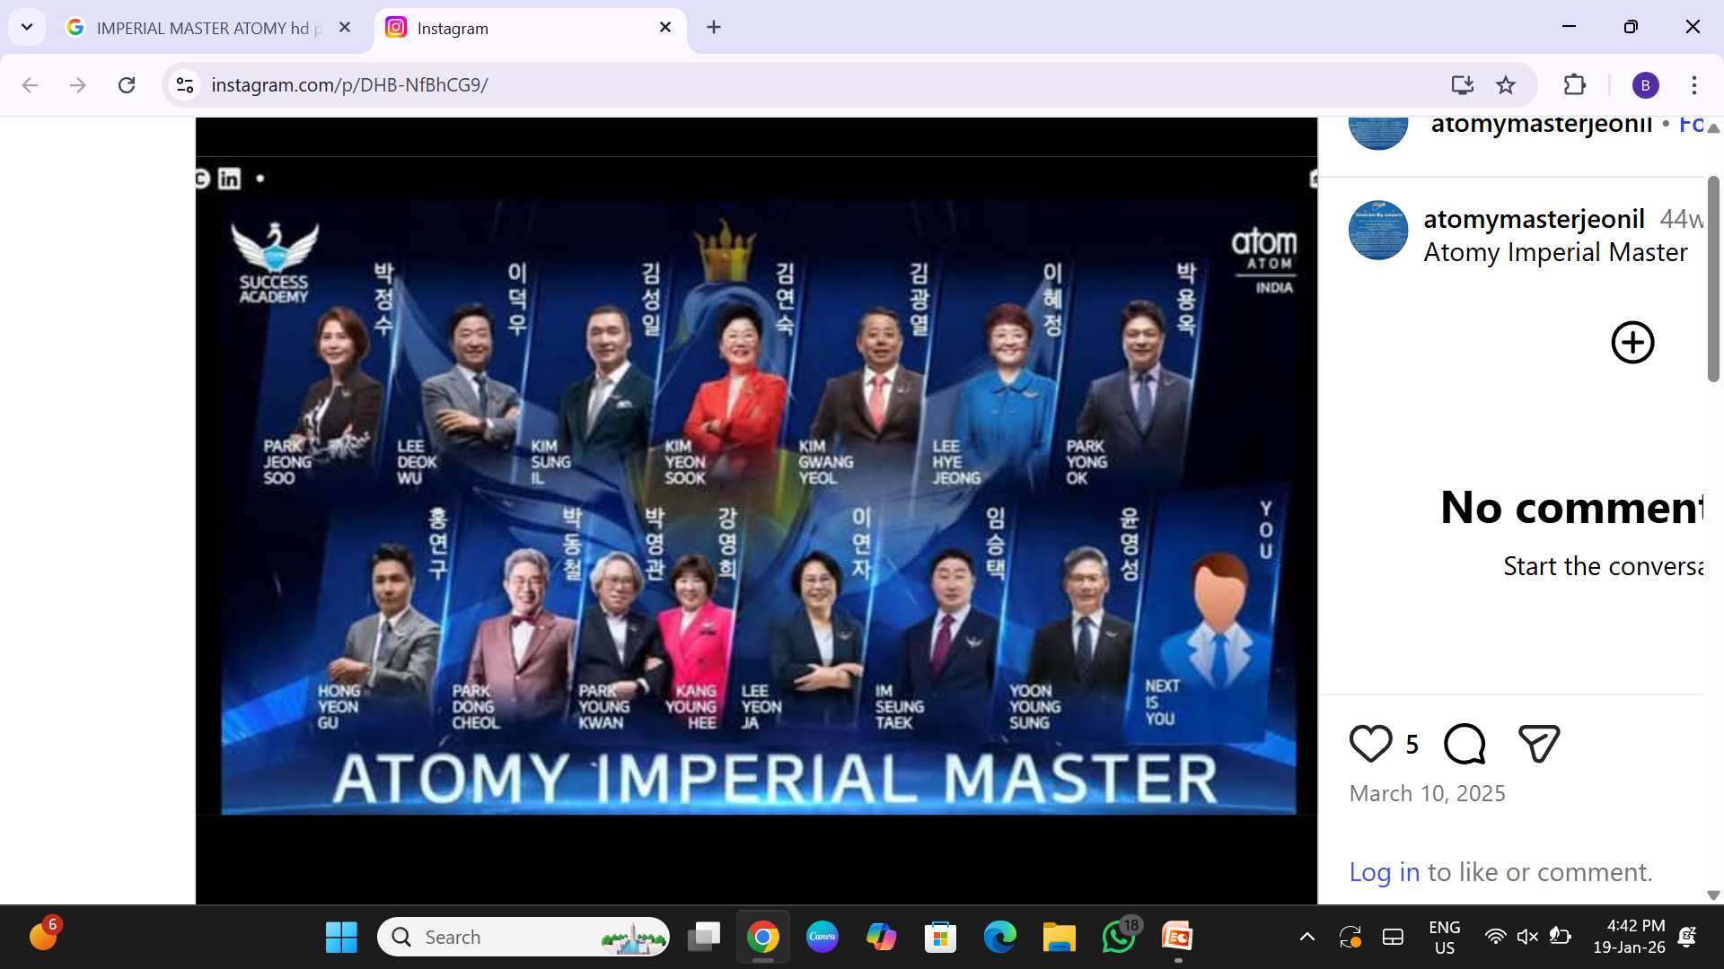
IMPERIAL MASTERS IN ATOMY

Slide 36
IMPERIAL MASTERS IN ATOMY
CASH PRIZE = 6 CRORE INDIAN RUPEES
MONTHLY INCOME = 80 LAKH/MONTH
LUXURY CAR ABOVE 50 LAKH VALUE
DRIVER WITH 50K SALARY
LUXURY VILLA
OFFICE SPACE 1500 SQ FEET APX.
VERY HIGH MONTHLY CREDIT LIMIT
HIGH VALUE VACATIONS WITH TRAVEL INCENTIVES

Slide 37
ATOMY IN INDIA
Rising demands in direct selling industry
Best opportunity for new enterpreneur with very low investment
Growing economy and increase demand for quality products

Slide 38


